Slide 1
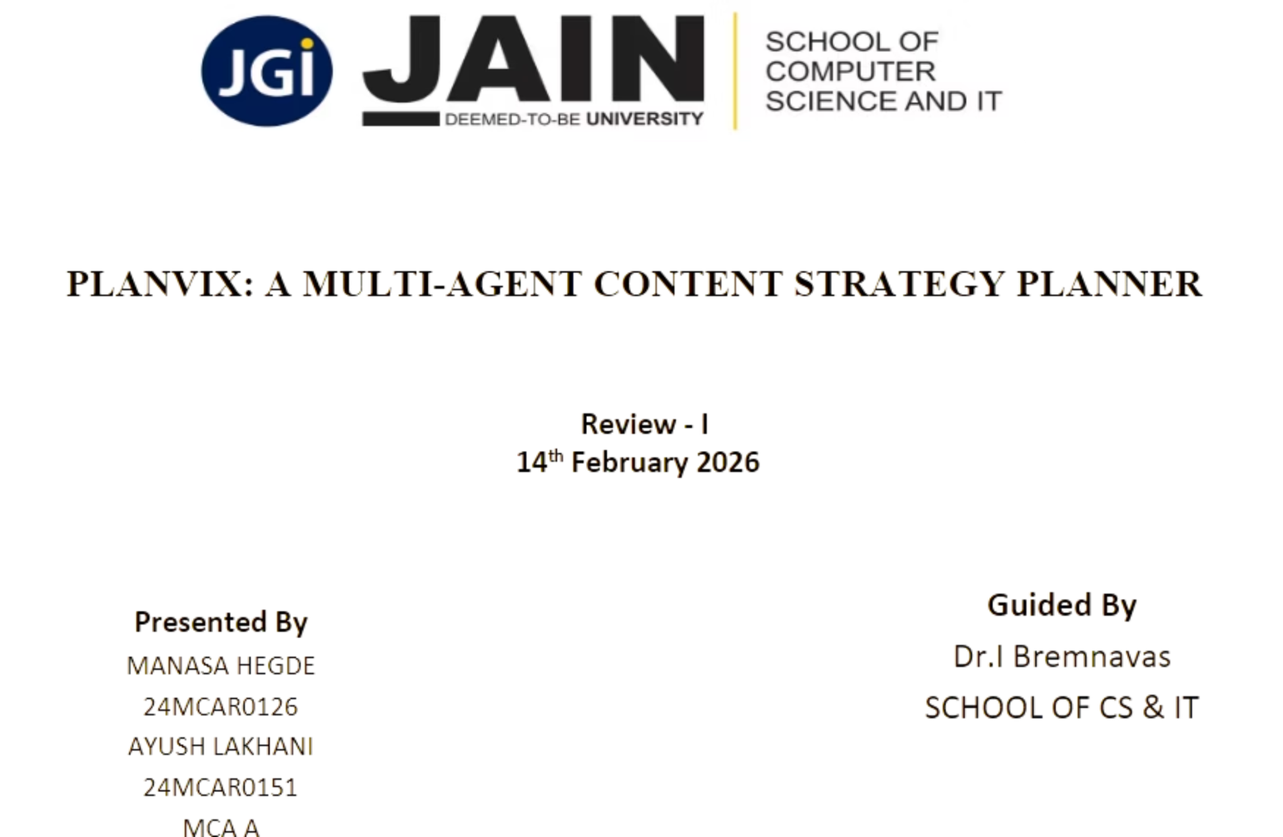
Notes:
1

Slide 2
Introduction
Digital platforms have transformed content into a strategic asset
Organizations require structured and aligned content planning
Traditional planning methods are time consuming, inconsistent and inefficient (like spreadsheets, brainstorming sessions and trail-and-error approaches)
Existing AI tools focus mainly on content generation
Planvix emphasizes strategic reasoning over content creation
PLANVIX is a dedicated SaaS platform that automates the entire role of a Chief Marketing Officer with five specialized AI agents working in coordinated sequence, delivering professional-grade content strategy in seconds instead of days
Notes:
2

Slide 3

Problem Statement
Existing AI tools focus mainly on content generation, not strategic planning
Outputs are often generic and lack audience-specific customization
Monolithic architectures lack collaborative reasoning and validation
Limited personalization based on user expertise level
No unified framework integrating multi-agent intelligence and knowledge grounding
Notes:
3

Slide 4
Proposed System (Planvix)
Multi-agent decision-support system
Experience-aware personalization
Retrieval-Augmented Generation (RAG)
Structured validation and optimization
Focus on strategic planning (not publishing)
Notes:
4

Slide 5
Scope of the Project
1
2
3
Intelligent content strategy planning system
Identifies relevant content themes
Analyzes and segments target audience
4
5
Recommends formats and distribution channels
Organizes structured planning calendars
Notes:
5

Slide 6
Multi-Agent Architecture
Agents in Planvix:
Advantages:
The Thinker - Customer insights
The Trend Hunter - Content gaps
The SEO Expert - Keyword discovery
The Planner - Strategy & calendar
The Fortune Teller - Performance prediction
Task distribution
Structured reasoning
Improved consistency
Strategic coherence
Notes:
6

Slide 7
Literature Review
Multi-agent systems distribute tasks among specialized agents, enabling collaborative reasoning and improved scalability
LLMs have limitations: static training data, outdated responses, hallucinations, and inconsistency in multi-step reasoning
Retrieval-Augmented Generation (RAG) solves LLM limitations by integrating external knowledge retrieval with text generation
RAG improves factual accuracy, contextual relevance, and reduces hallucination risks
Multi-agent + RAG integration enables intelligent, adaptive planning with dynamic personalization
Existing tools lack unified framework combining multi-agent collaboration, RAG, and personalization
Planvix fills this gap by integrating multi-agent orchestration with retrieval-augmented intelligence for strategic content planning
Notes:
7

Slide 8
System Requirements
Hardware:
Software:
Minimum Requirements:
Operating System:
Processor: Dual-core CPU (2.0 GHz or higher)
RAM: 4 GB
Storage: 2 GB free disk space
Internet: Stable broadband connection (5 Mbps+)
Windows 10/11
macOS 10.15 (Catalina) or later
Linux (Ubuntu 20.04+, Debian, Fedora, etc.)
Notes:
8

Slide 9
Functional Requirements
Accept user goals & experience level
Coordinate multiple autonomous agents
Generate structured strategy
Validate contextual consistency
Support retrieval-based knowledge grounding
Notes:
9

Slide 10
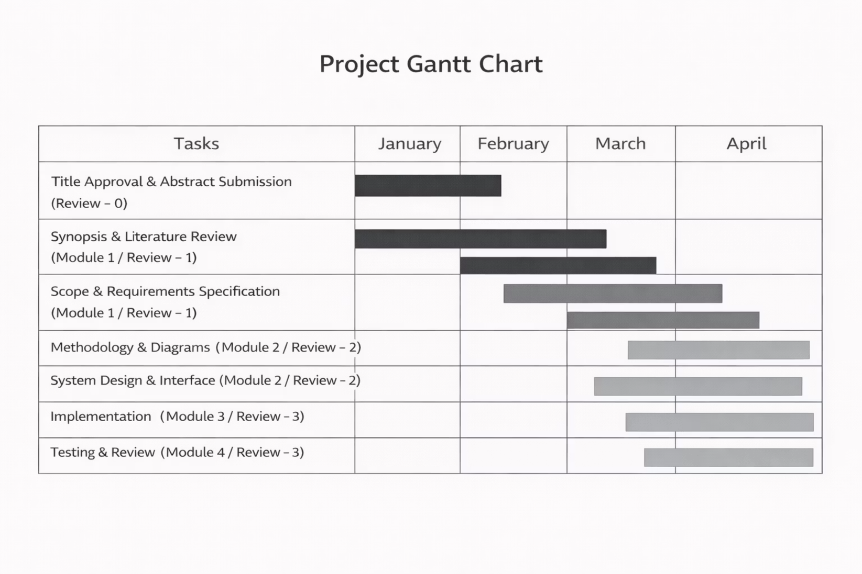
Gantt Chart
Notes:
10

